Slide 1
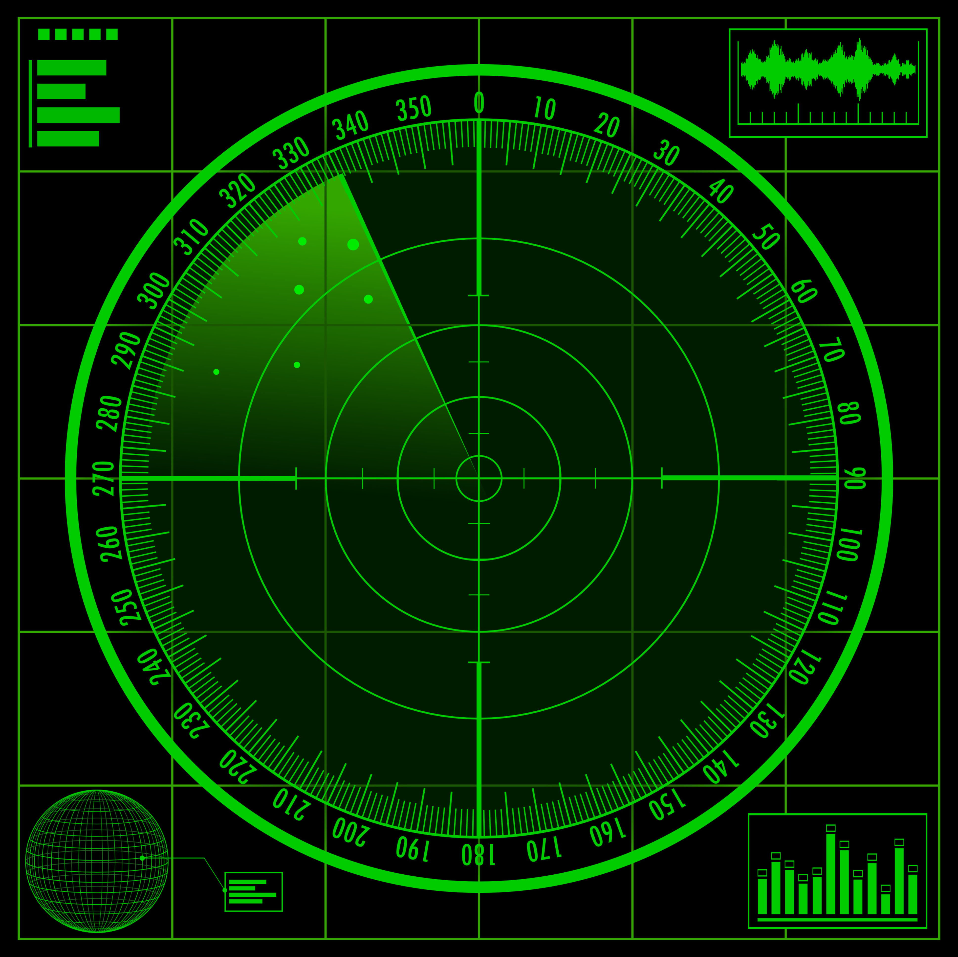
BATTLESHIP

Slide 2

THE COMMERCIAL

Slide 3
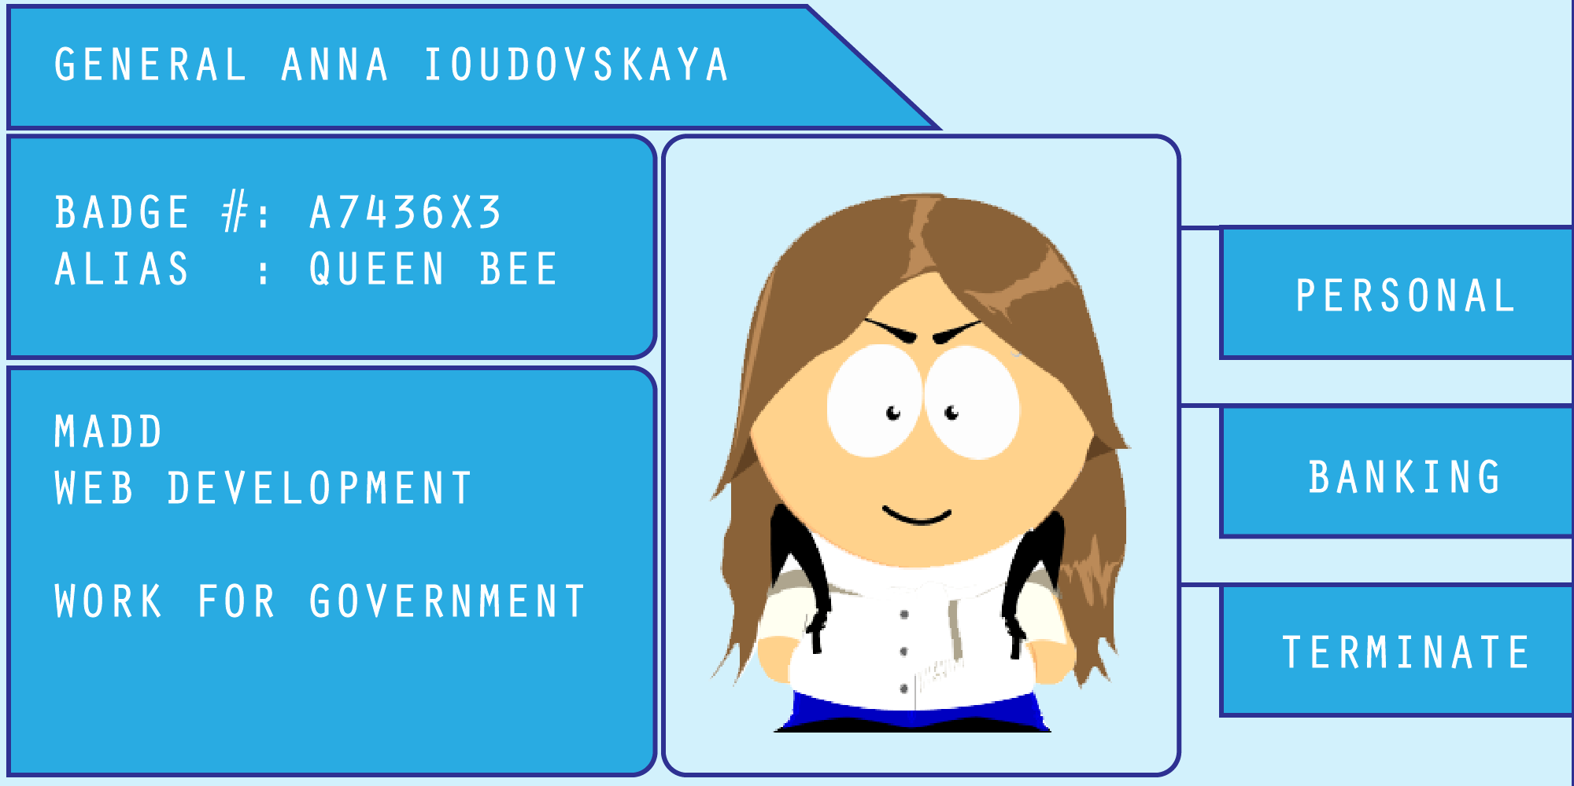
KID A

Slide 4
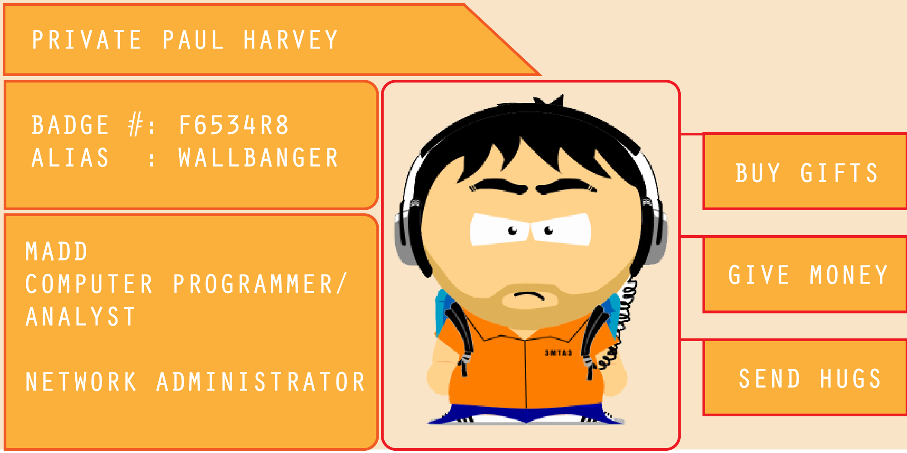
KID B

Slide 5
WHY BATTLESHIP?
We choose to go to the Moon in this decade and do the other things, not because they are easy, but because they are hard [JFK]
It’s Paul’s fault. He worked on Battleship before and wanted to bring it to a new platform.

Slide 6
TEAM DYNAMIC
No punches thrown
A few cocktails consumed
Project problems centered around time constraints for the final deliverable due to:
size of project
work schedule of one member
illness of one member
large amount of bugs

Slide 7
THE PROCESS
Proposal including Wireframes
UI Design
Final Project

Slide 8
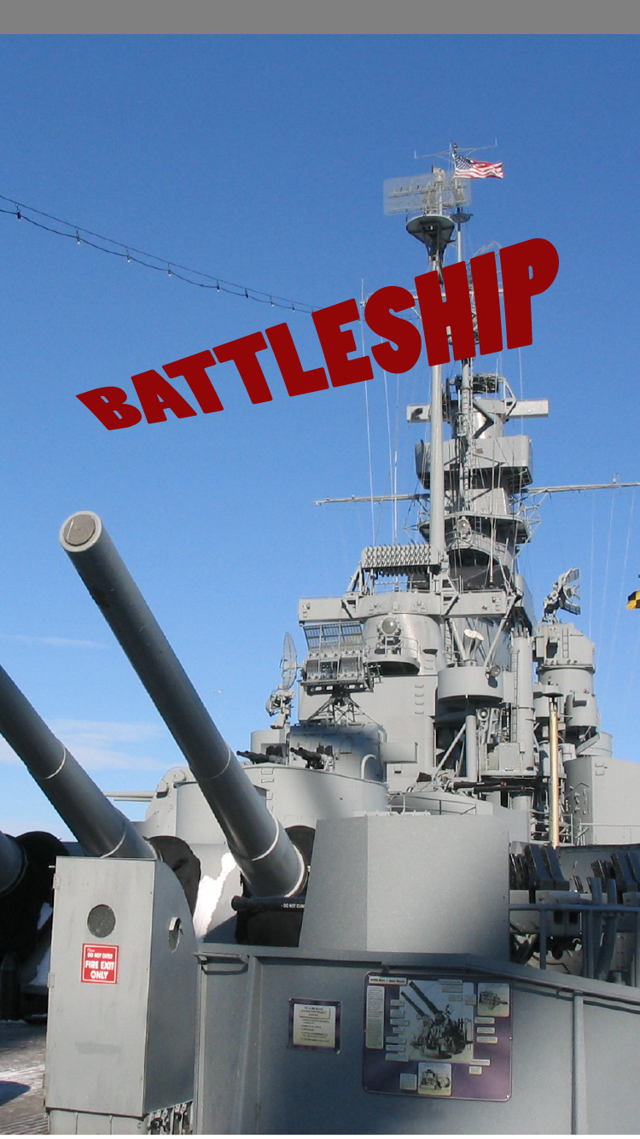
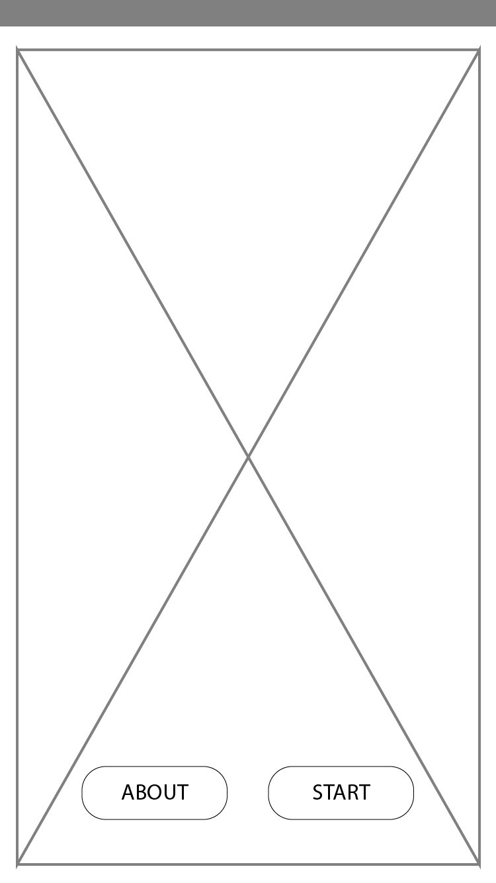
WIREFRAME I
SPLASH SCREEN
LANDING PAGE

Slide 9
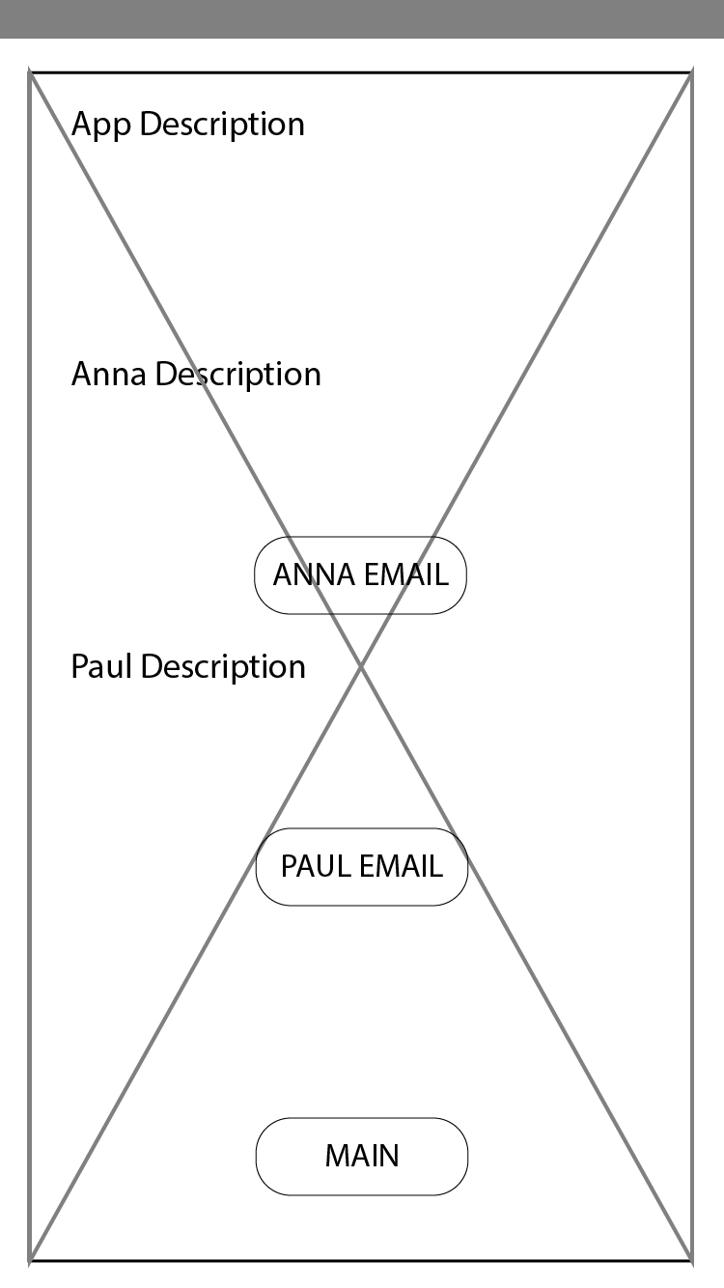
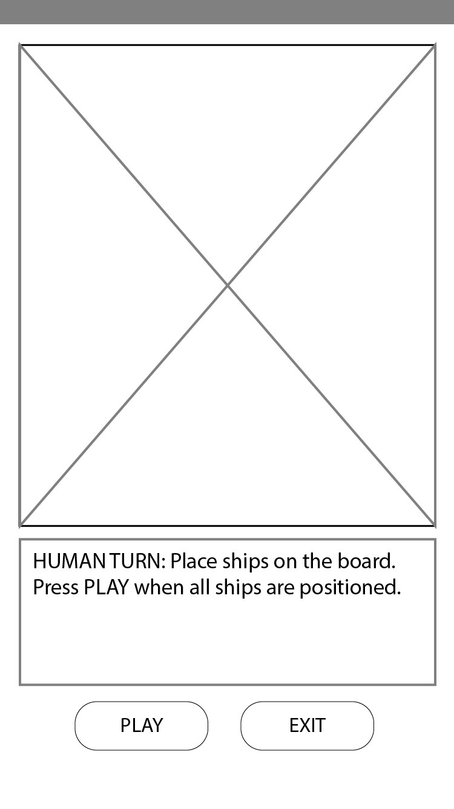
WIREFRAME II
ABOUT PAGE
GAME SETUP

Slide 10
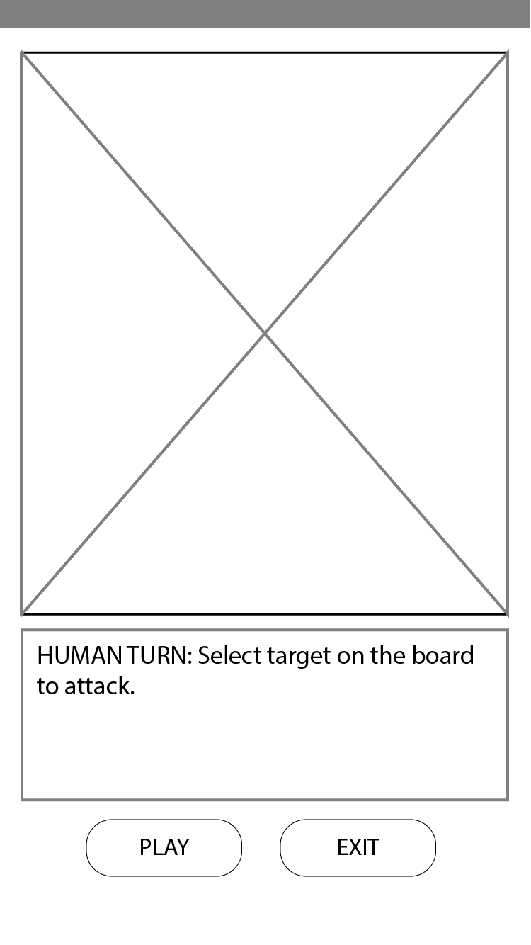
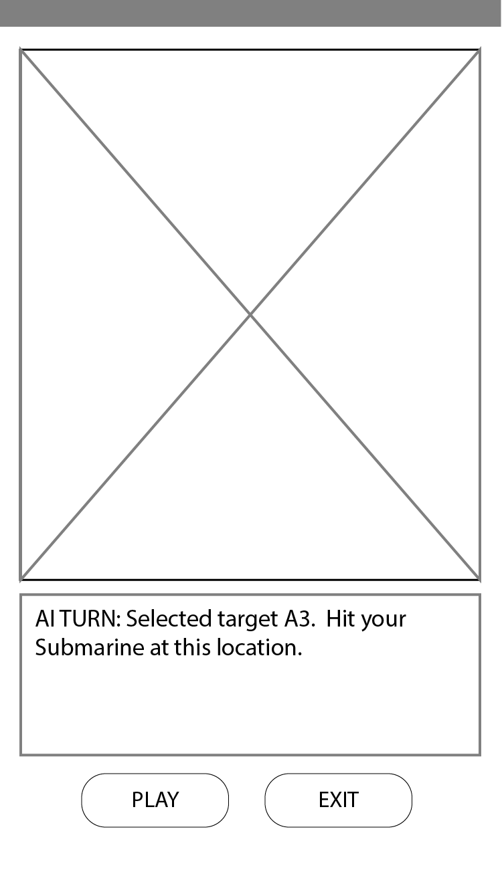
WIREFRAME III
HUMAN GAME PLAY
AI GAME PLAY

Slide 11
UI DESIGN
VISUAL STUDIO 2015
C#
UNIVERSAL WINDOWS PLATFORM
XAML
OTHER TOOLS
ILLUSTRATOR
PHOTOSHOP
PAINT (SORRY DEVON)

Slide 12
UI DESIGN II
ISSUES
MAKING THE GRID
SPLASHSCREEN
LEARNING XAML PROPERTIES ON THE FLY
NOT ALL PROGRAMS ARE 100% RELIABLE

Slide 13
DEVELOPMENT I
CLASSES THAT ARE IN THE PROJECT ARE:
PLAYER
GAMEBOARD
SHIP
COORDINATES

Slide 14
DEVELOPMENT II
FOR THE FINAL ASSIGNMENT:
SPLASHSCREENS (WORKING)
ABOUT PAGE (WORKING)
GAME SETUP (BUGGY)
AI & HUMAN GAME PLAY (CRASHY)
HIGH SCORE (NOT COMPLETED)

Slide 15
DEVELOPMENT III
BUT FOR YOU TODAY:
SPLASHSCREENS (WORKING)
ABOUT PAGE (WORKING)
GAME SETUP (WORKING)
AI & HUMAN GAME PLAY (WORKING – MAYBE BUGGY)
HIGH SCORE (NOT COMPLETED)
LET’S HAVE A LOOK!!!

